Slide 1
Recap: some rhetorical tools …
Last time, we introduced Rowe’s method of exploring a claim by replacing one word or concept with another. We also discussed Schrepfer’s three questions:
How does it function? (Or: What is its goal?)
Who does it benefit?
Where is the power?
There was also Ponton & Raimo’s Framing environmental discourse. Greta Thunberg, metaphors, blah blah blah! (2024)
You applied those rhetorical tools to Greta Thunberg’s 2019 presentation at the UN Climate Action Summit. So let’s talk about that a bit.

Slide 2
My message is that we'll be watching you.
This is all wrong. I shouldn't be up here. I should be back in school on the other side of the ocean. Yet you all come to us young people for hope. How dare you!
You have stolen my dreams and my childhood with your empty words. And yet I'm one of the lucky ones. People are suffering. People are dying. Entire ecosystems are collapsing. We are in the beginning of a mass extinction, and all you can talk about is money and fairy tales of eternal economic growth. How dare you!
You say you hear us and that you understand the urgency. But no matter how sad and angry I am, I do not want to believe that. Because if you really understood the situation and still kept on failing to act, then you would be evil. And that I refuse to believe.
The popular idea of cutting our emissions in half in 10 years only gives us a 50% chance of staying below 1.5 degrees, and the risk of setting off irreversible chain reactions beyond human control. Fifty percent may be acceptable to you. But those numbers do not include tipping points, most feedback loops, additional warming hidden by toxic air pollution or the aspects of equity and climate justice. They also rely on my generation sucking hundreds of billions of tons of your CO2 out of the air with technologies that barely exist. So a 50% risk is simply not acceptable to us — we who have to live with the consequences.
To have a 67% chance of staying below a 1.5 degrees global temperature rise – the best odds given by the IPCC – the world had 420 gigatons of CO2 left to emit back on Jan. 1st, 2018. Today that figure is already down to less than 350 gigatons.
How dare you pretend that this can be solved with just 'business as usual' and some technical solutions? With today's emissions levels, that remaining CO2 budget will be entirely gone within less than 8 1/2 years. There will not be any solutions or plans presented in line with these figures here today, because these numbers are too uncomfortable. And you are still not mature enough to tell it like it is.
You are failing us. But the young people are starting to understand your betrayal. The eyes of all future generations are upon you. And if you choose to fail us, I say: We will never forgive you. We will not let you get away with this.
Right here, right now is where we draw the line. The world is waking up. And change is coming, whether you like it or not. Thank you.

Slide 3
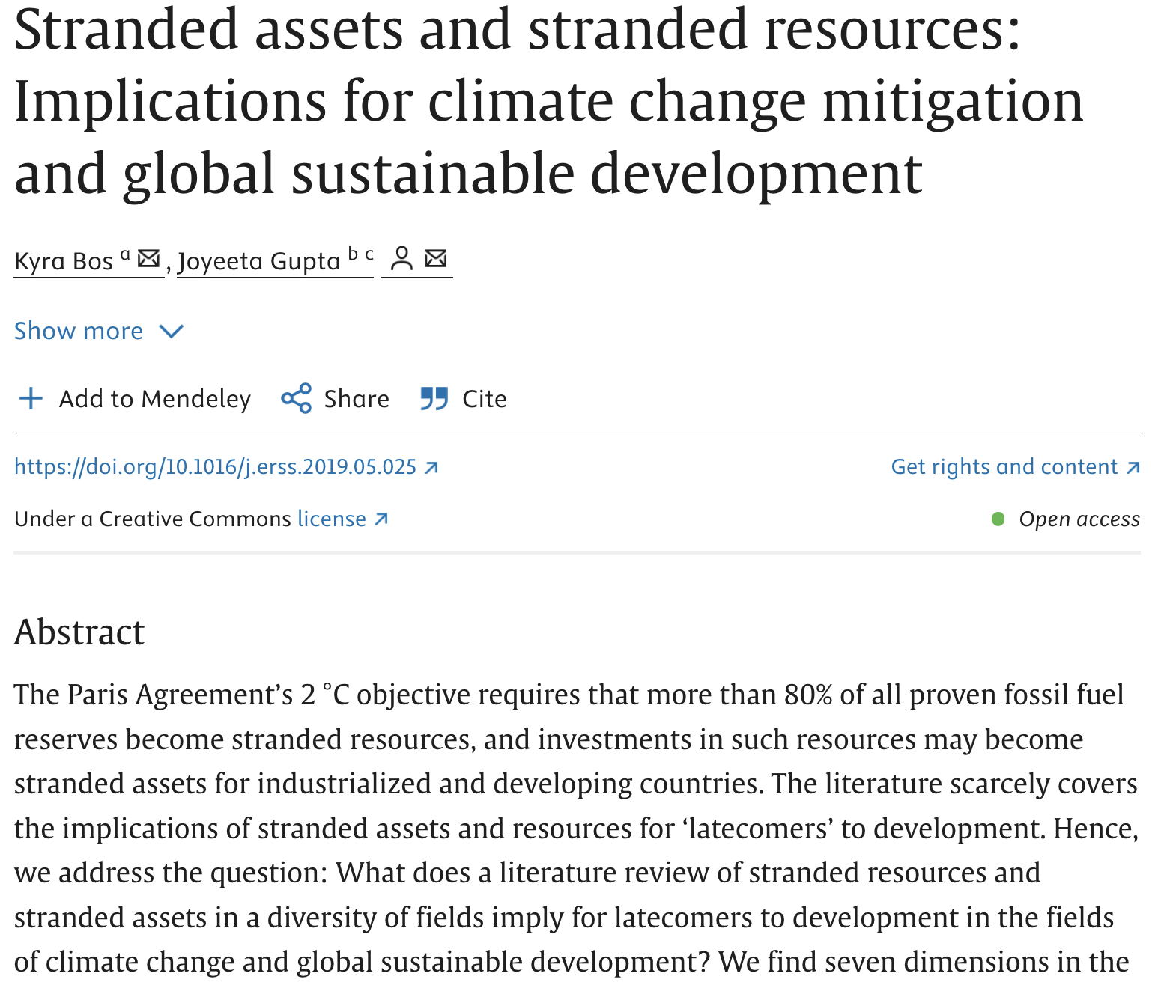
Back to mitigation … Mitigation on the supply side means stranded assets

Slide 4
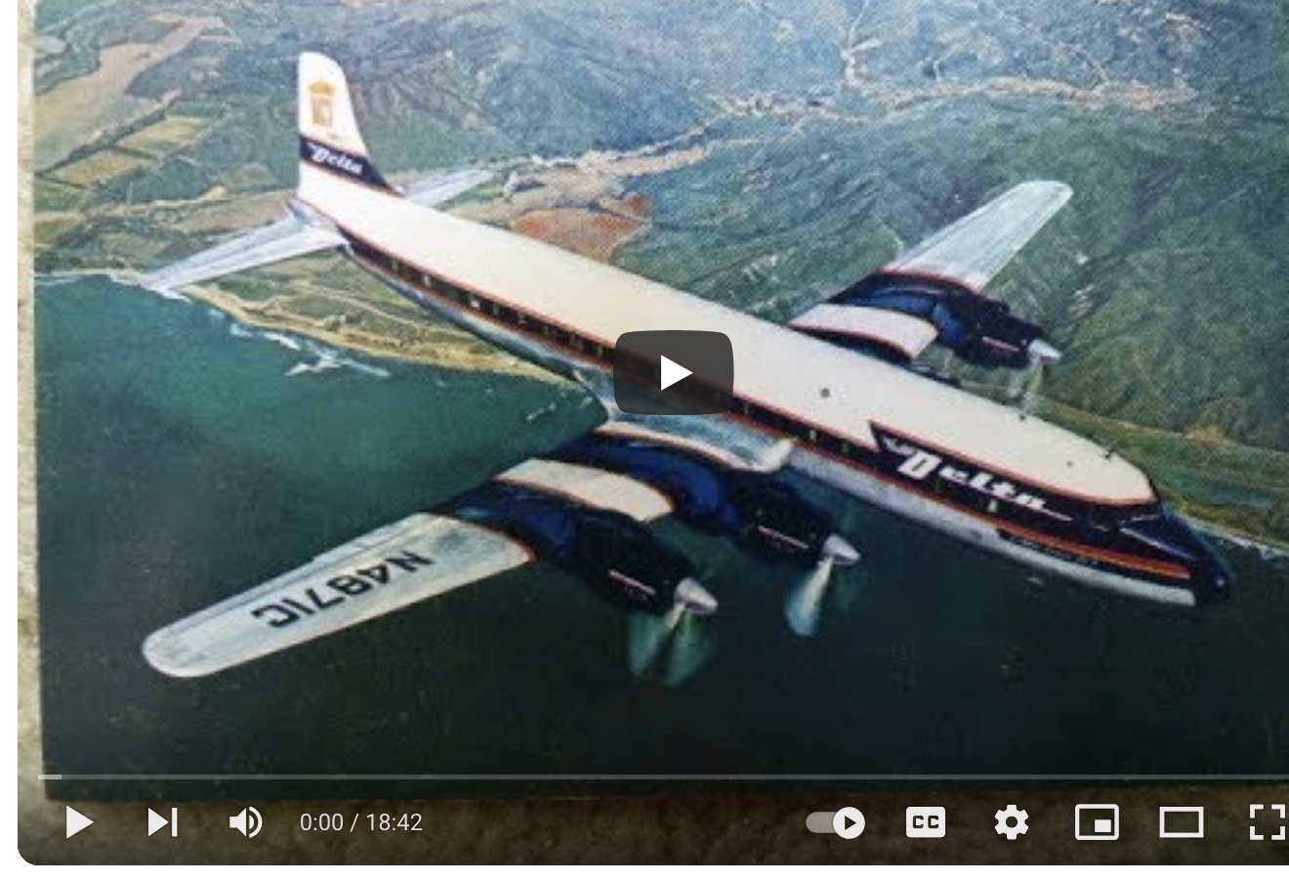
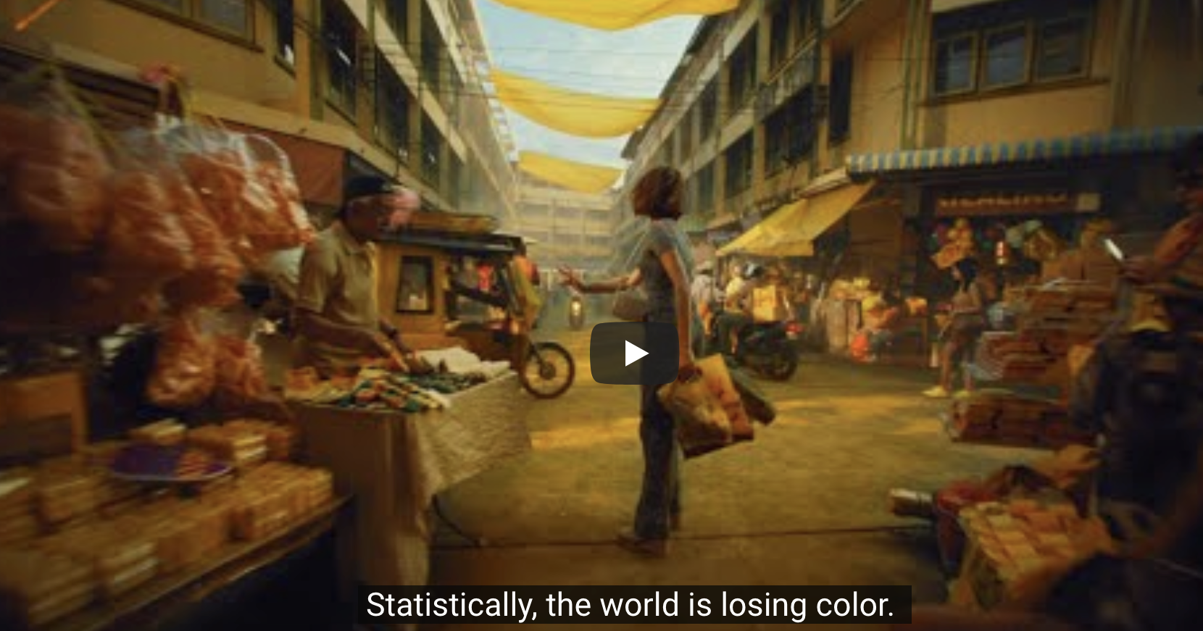
Mitigation on the demand side means behavioral changes on the part of 1st worlders that run up against powerful socioeconomic (advertising) forces
This is Delta (1957)
The World is Your Kaleidoscope (about 2020)

Slide 5
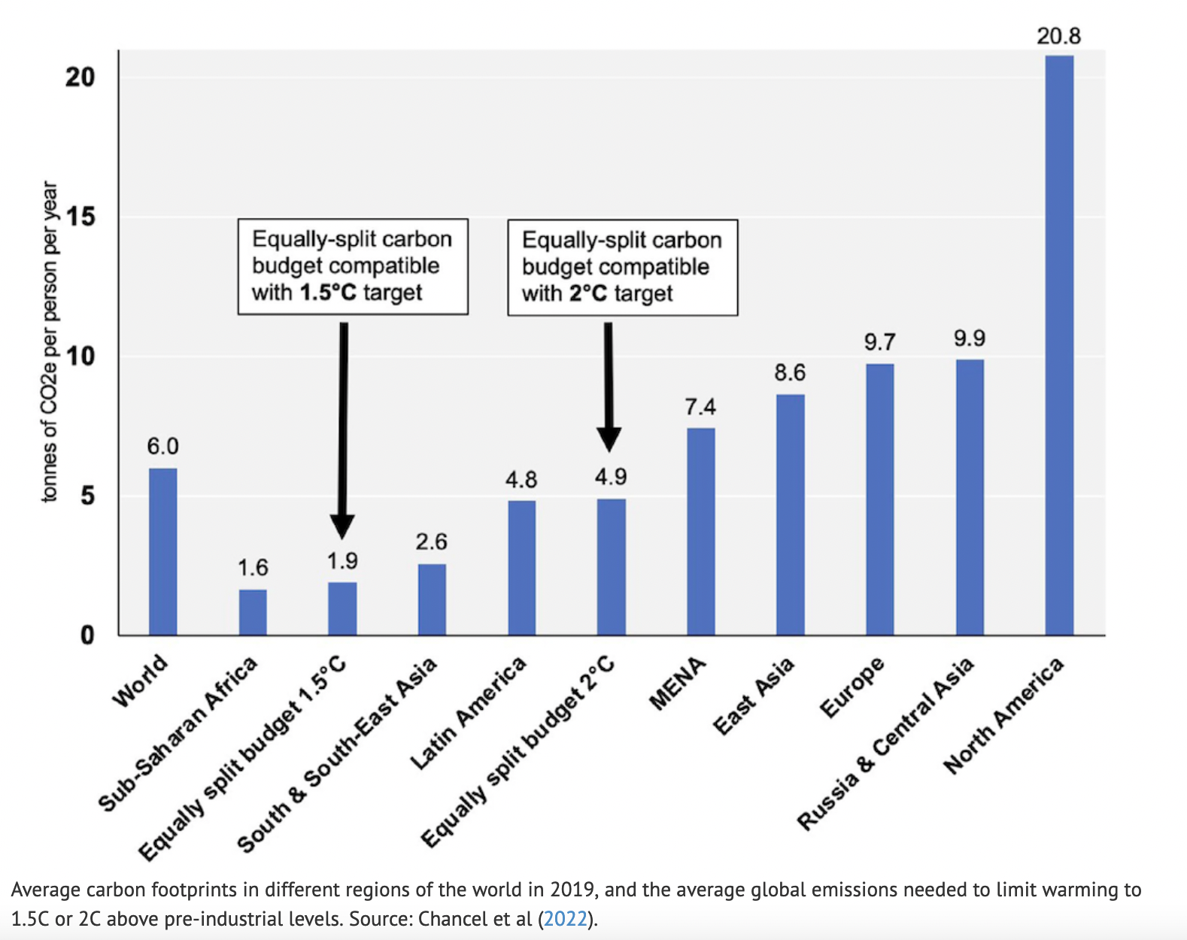
But whose demand? We’ve seen big disparities in consumption from country to country …

Slide 6
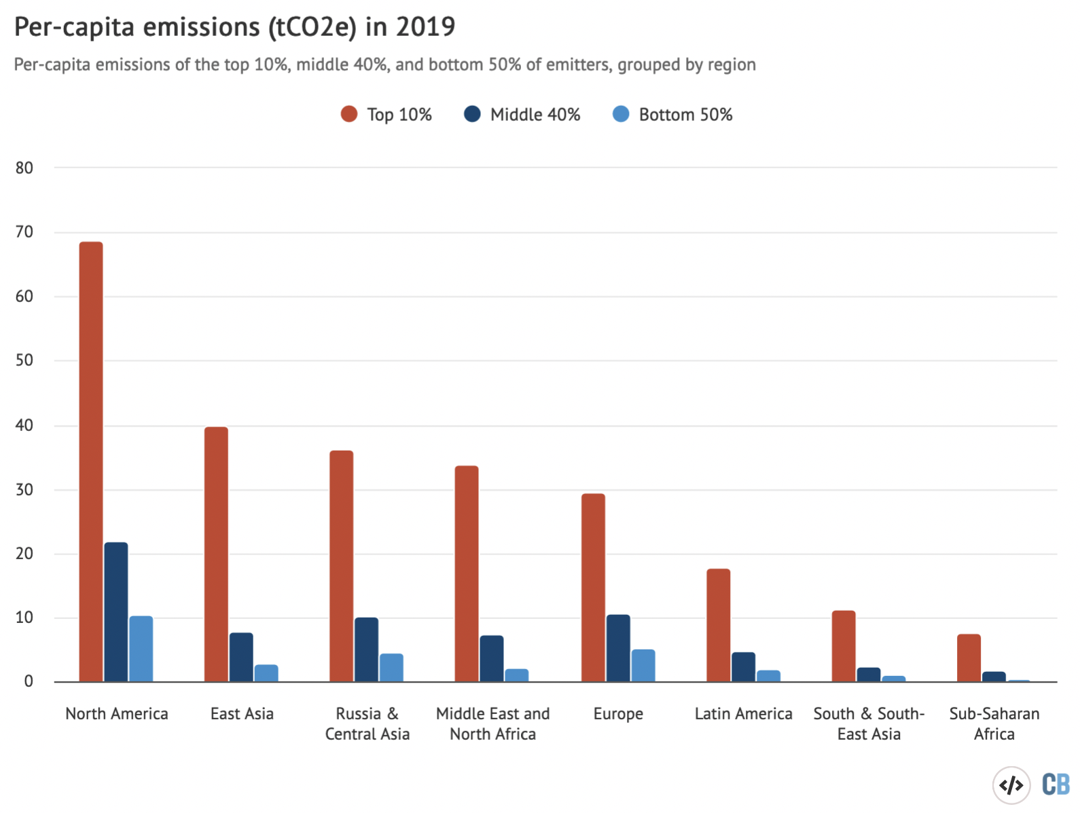
.. and there’s a lot of in-country disparity too

Slide 7
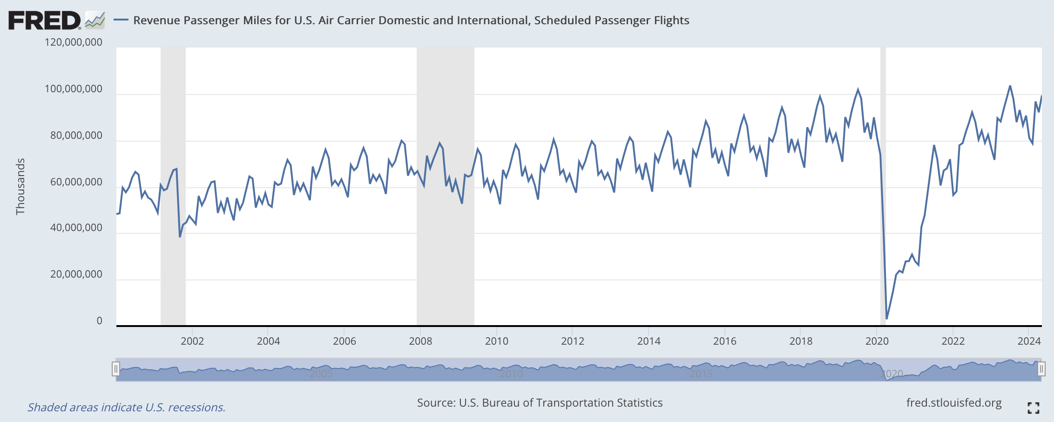
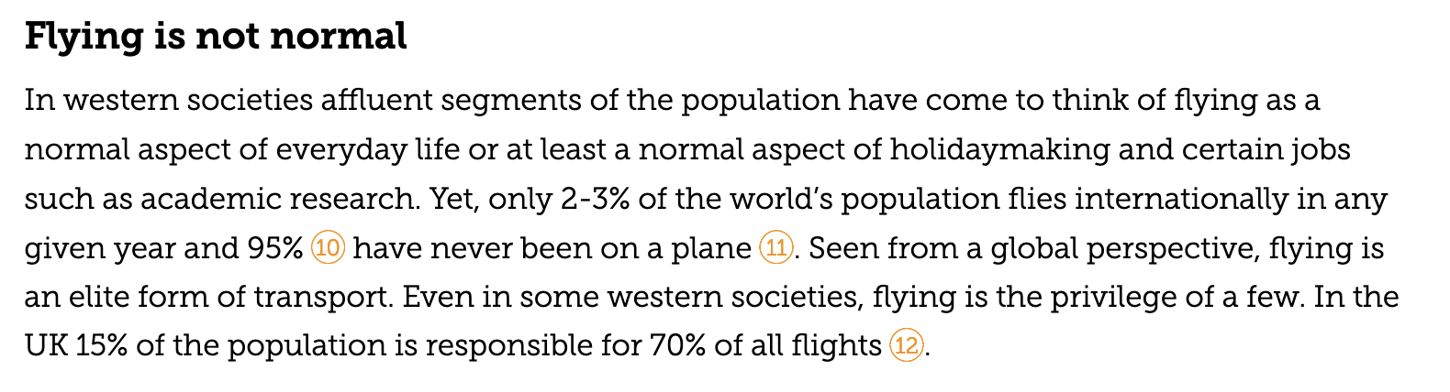
Some interesting facts about flying

Slide 8
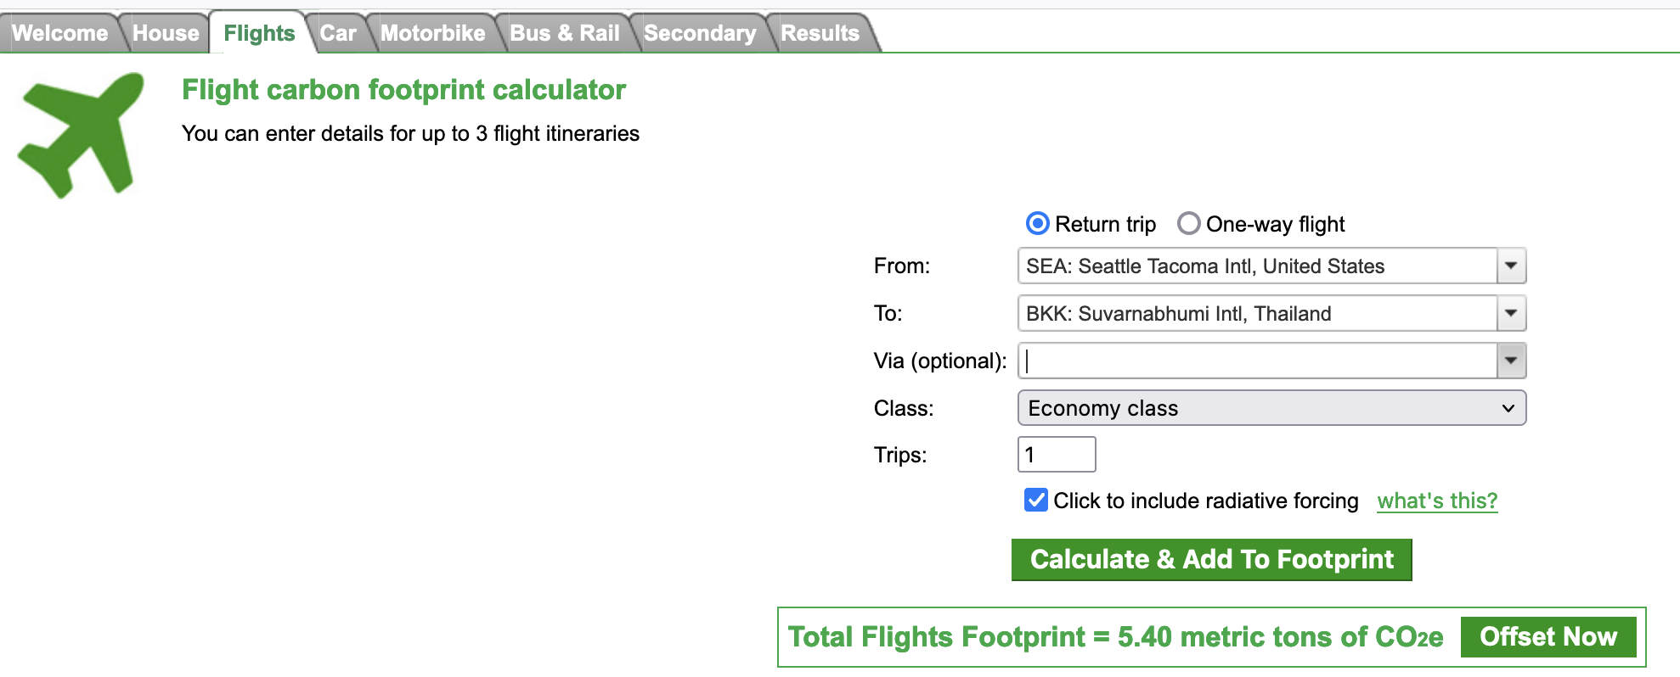
The climate impact of flying … we can quantify the CO₂

Slide 9
The climate impact of flying … we can quantify the CO₂
Is 5.4 metric tons a lot?

Slide 10
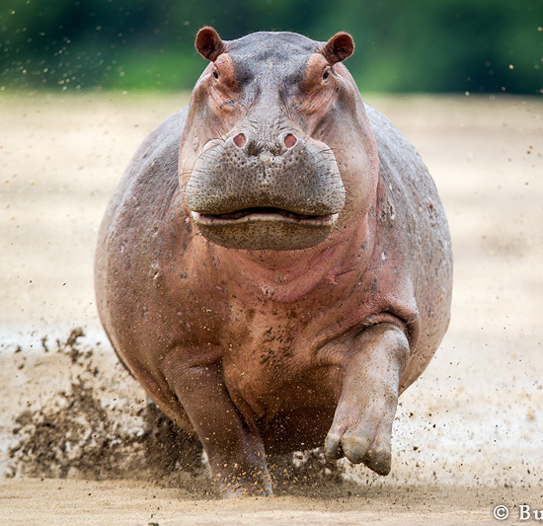
The climate impact of flying … we can quantify the CO₂
Is 5.4 metric tons a lot?

Slide 11
Let’s compare to the per-capita budget needed to avoid $2℃$ warming
Carbon Privilege = 16 GtC/yr
Seatac <-> Bankok

Slide 12

Delta isn’t the only organization that stands to benefit from enticing people to fly

Slide 13
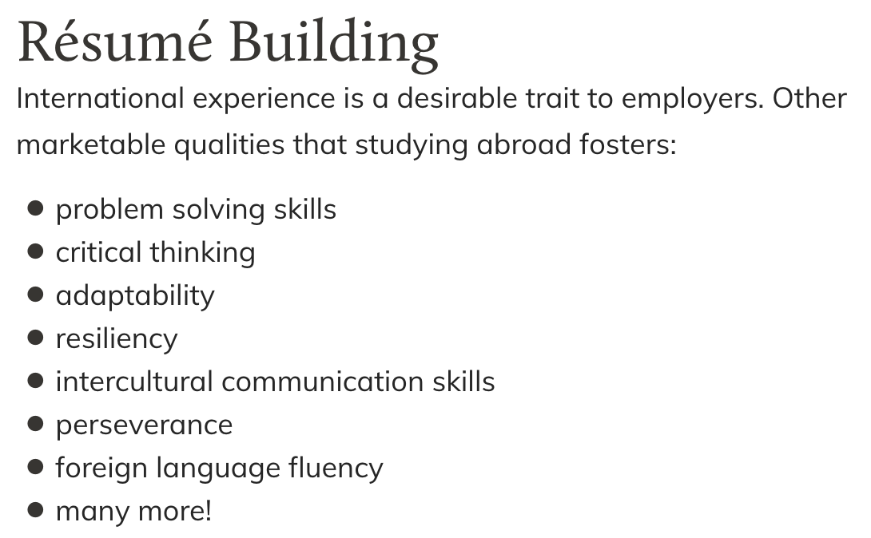
Delta isn’t the only organization that stands to benefit from enticing people to fly

Slide 14
Delta isn’t the only organization that stands to benefit from enticing people to fly
How does it function? (Or: What is its goal?)
Who does it benefit?
Where is the power?

Slide 15
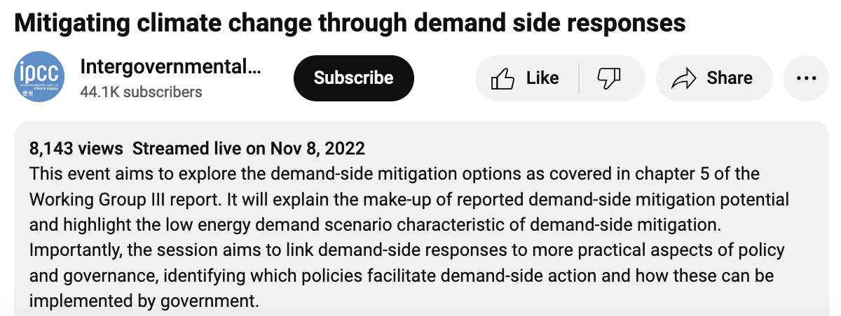
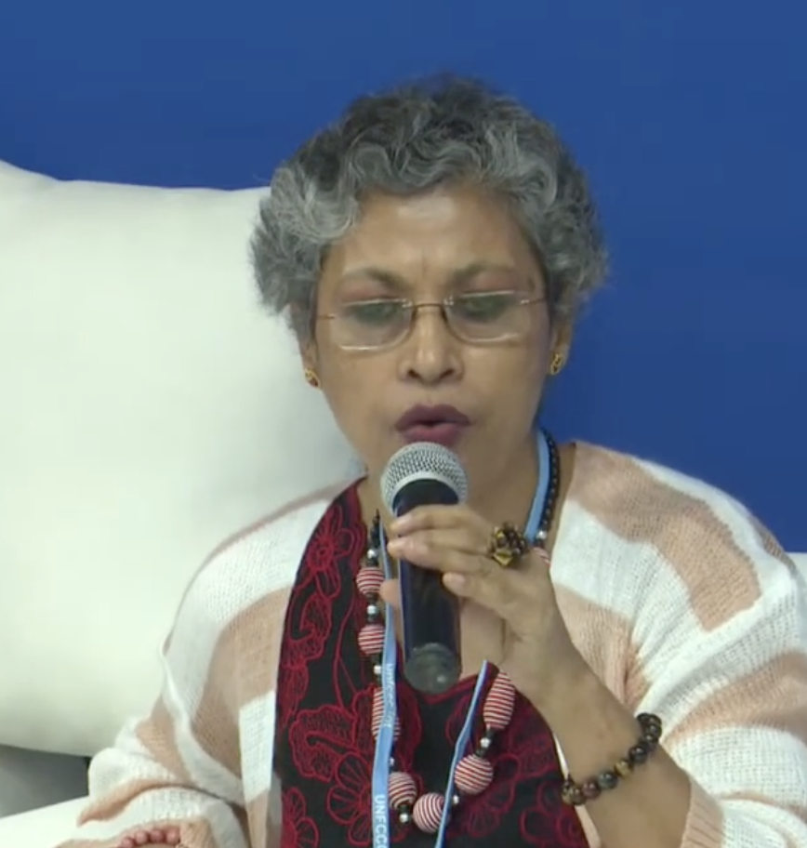
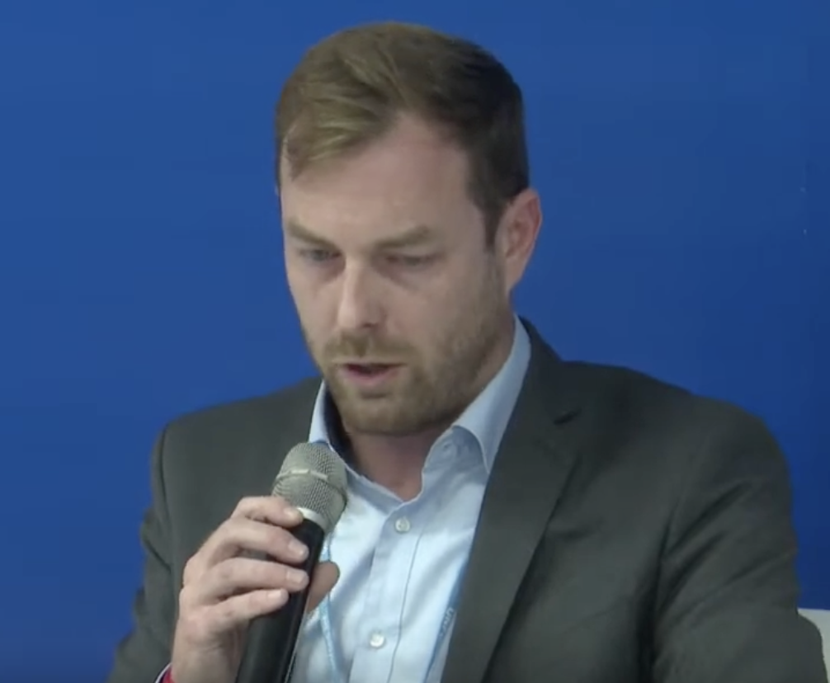
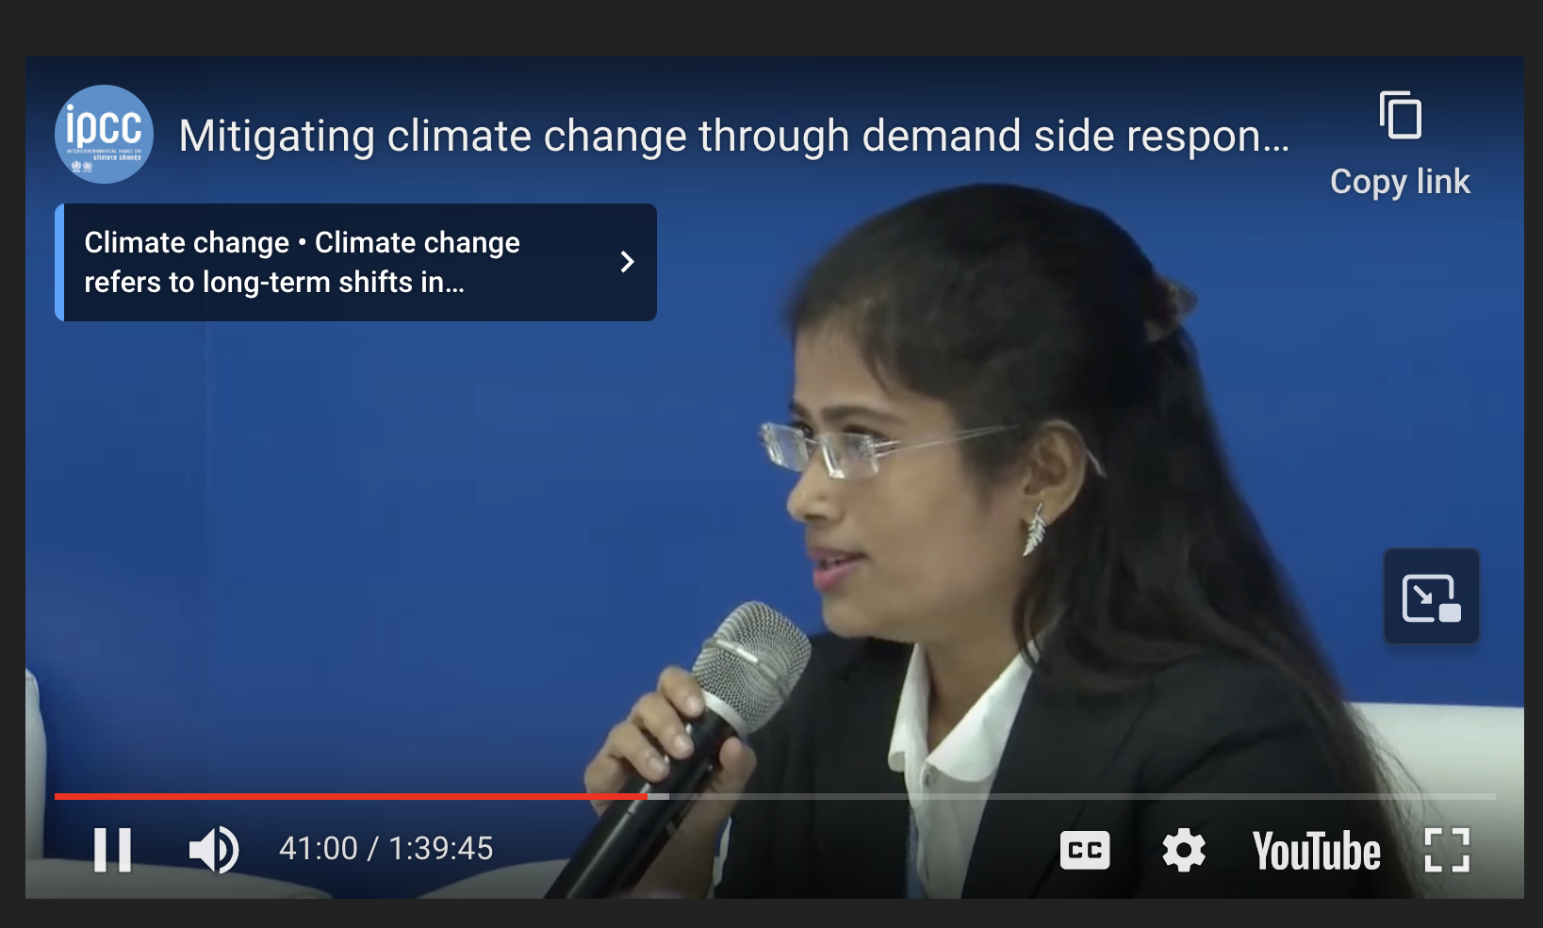

Next discussion assignment: IPCC Panel Discussion on mitigating climate change through demand side reductions
Joyashree Roy, Jadavpur University
David McCollum, Oak Ridge Nat’l Lab
Shreya Some, Asia Institute of Technology
Nick Eyre, Oxford

